Slide 1
Data Engineering Zoomcamp
Analytics Engineering

Slide 2
1
What is Analytics Engineering?
Let’s start with some background

Slide 3
DATA DOMAIN DEVELOPMENTS
Massively parallel processing (MPP) databases
SQL-first
BI tools
Self service analytics
1
3
5
2
4
6
Data-pipelines-as-a-service
Version control systems
Data Governance
Notes:
MPP/Cloud-based data warehouses (Redshift, BigQuery and Snowflake) made data storage and processing affordable and fast.
Data pipeline services (Stitch, Fivetran) simplified the ETL process
SQL-first tools (Looker) increased SQL awareness and facilitated self-service and data governance

Slide 4
ROLES IN A DATA TEAM
Introduces the good software engineering practices to the efforts of data analysts and data scientists
Uses data to answer questions and solve problems.
Data Engineer
Analytics Engineer
Data Analyst
Prepares and maintain the infrastructure the data team needs.
Brings an analytical and business-outcomes mindset to the efforts of data engineering
Notes:
While data scientists and analysts are writing a lot of code, being great software engineers isn’t what they’ve been trained for and it often isn’t their first priority. Similarly, while data engineers are great software engineers, they don’t have training in how they data are actually used and so can’t always partner effectively with analysts and data scientists.
I believe this gap should be filled in by analytics engineers.

Slide 5
TOOLING
Cloud data warehouses like Snowflake, Bigquery, Redshift
Data Loading
Data Storing
Tools like dbt or Dataform
Data modelling
BI tools like google data studio, Looker, Mode or Tableau
Data presentation

Slide 6
2
Data Modelling concepts
Let’s start with the useful stuff

Slide 7
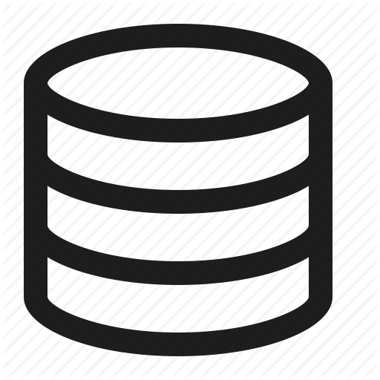


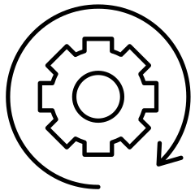

ETL vs ELT
Extract
Extract
Load
Reporting
Reporting
Transform
Load
Transform
sources
Data warehouse
sources
Data warehouse
Faster and more flexible data analysis.
Lower cost and lower maintenance
Slightly more stable and compliant data analysis
Higher storage and compute costs
Notes:
ETL takes longer to implement but results in cleaner data.
The ELT approach enables faster implementation than the ETL process, though the data is messy once it is moved. The transformation occurs after the load function, preventing the migration slowdown that can occur during this process.
ELT decouples the transformation and load stages, ensuring that a coding error (or other error in the transformation stage) does not halt the migration effort. Additionally, ELT avoids server scaling issues by using the processing power and size of the data warehouse to enable transformation (or scalable computing) on a large scale.

Slide 8
Kimball’s Dimensional Modeling
Objective
● Deliver data understandable to the business users
● Deliver fast query performance
Approach
Prioritise user understandability and query performance over non redundant data (3NF)
Other approaches
● Bill Inmon
● Data vault

Slide 9
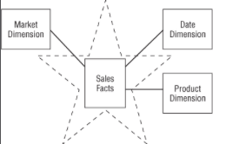
Elements of Dimensional Modeling
Facts tables
● Measurements, metrics or facts
● Corresponds to a business process
● “verbs”
Dimensions tables
● Corresponds to a business entity
● Provides context to a business process
● “nouns”
Image: The data warehouse toolkit

Slide 10




Architecture of Dimensional Modeling
Stage Area
● Contains the raw data
● Not meant to be exposed to everyone
Processing area
● From raw data to data models
● Focuses in efficiency
● Ensuring standards
Presentation area
● Final presentation of the data
● Exposure to business stakeholder

Slide 11
3
What is dbt?
Let’s dive into the important stuff

Slide 12

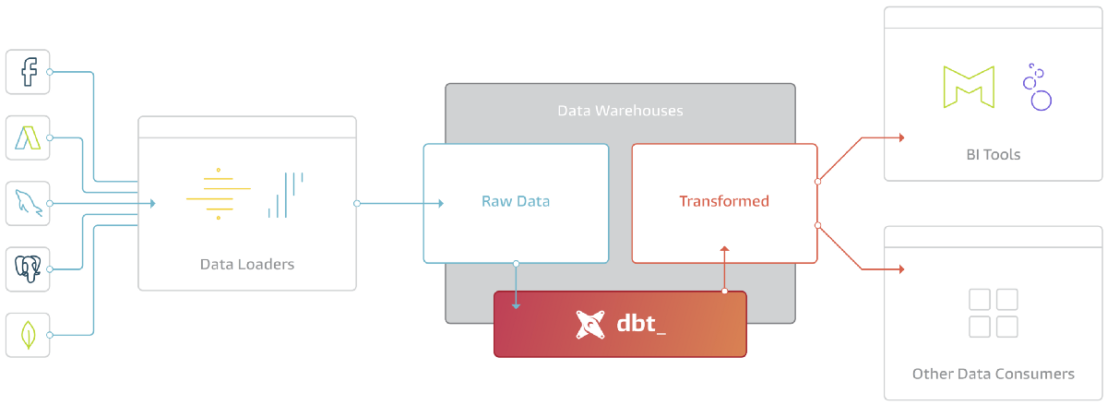
What is dbt?
dbt is a transformation tool that allows anyone that knows SQL to deploy analytics code following software engineering best practices like modularity, portability, CI/CD, and documentation.
Deployment (Version control and CI/CD)
Test and document
Develop
Image: getdbt.com

Slide 13
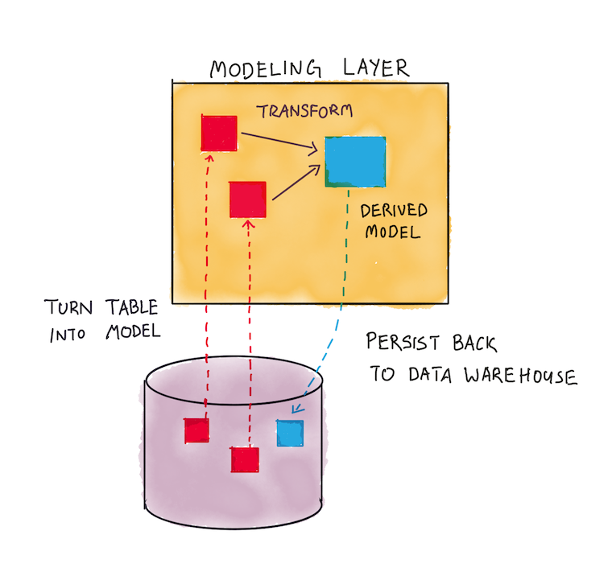
How does dbt work?
Each model is:
A *.sql file
Select statement, no DDL or DML
A file that dbt will compile and run in our DWH
Image: holistics.io and getdbt.com

Slide 14
How to use dbt?
dbt Core
Open-source project that allows the data transformation
● Builds and runs a dbt project (.sql and .yml files)
● Includes SQL compilation logic, macros and database adapters
● Includes a CLI interface to run dbt commands locally
● Opens source and free to use
dbt Cloud
SaaS application to develop and manage dbt projects.
● Web-based IDE to develop, run and test a dbt project
● Jobs orchestration
● Logging and Alerting
● Integrated documentation
● Free for individuals (one developer seat)

Slide 15
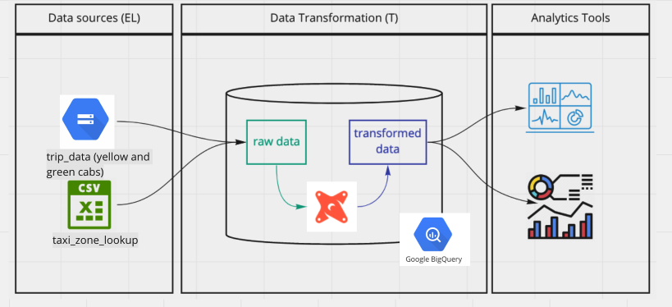
How are we going to use dbt?
BigQuery
Development using cloud IDE
No local installation of dbt core
Postgres
Development using a local IDE of your choice.
Local installation of dbt core connecting to the Postgres database
Running dbt models through the CLI

Slide 16
4
Starting a dbt project
Now to the fun part!

Slide 17
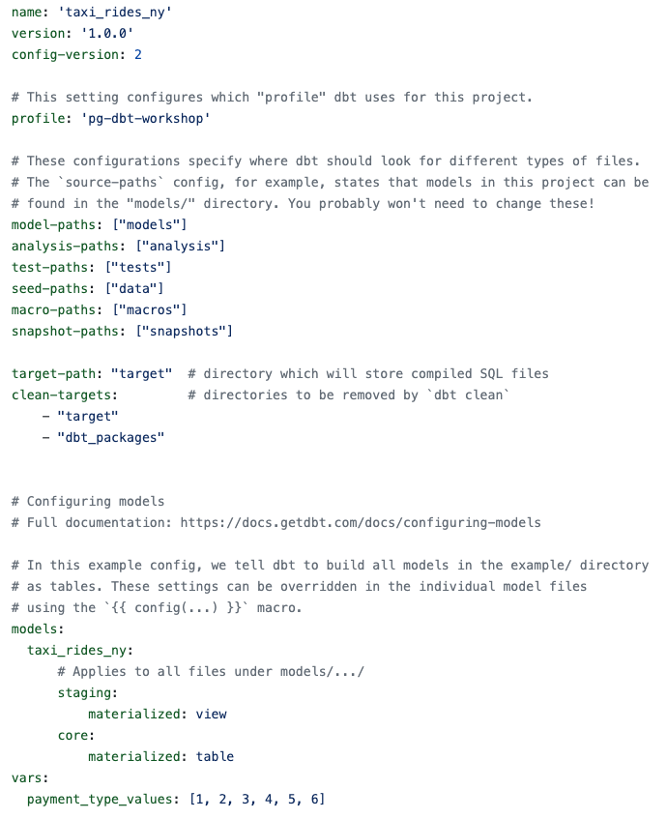
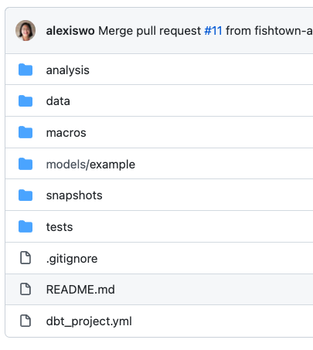
Create a new dbt project
dbt provides an starter project with all the basic folders and files.
There are essentially two ways to use it:
With the CLI
After having installed dbt locally and
setup the profiles.yml, run dbt init in the path we want to start the project to clone the starter project.
With dbt cloud
After having set up the dbt cloud credentials (repo and dwh) we can start the project from the web-based IDE
dbt_proyect.yml
Starter project structure
Extra documentation link

Slide 18
5
Development of dbt models
Now to the fun part!

Slide 19
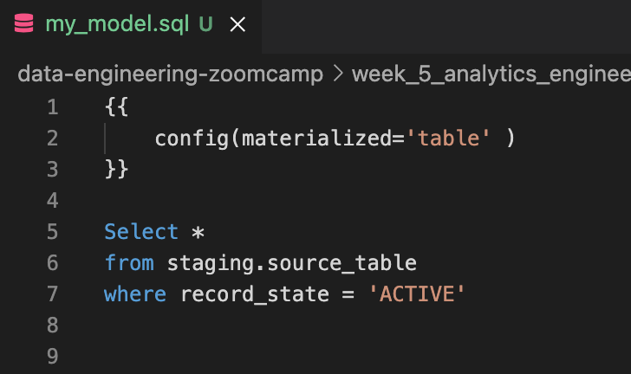
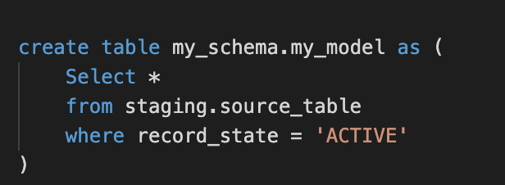

Anatomy of a dbt model
dbt model
Compiled code
Runs compiled code in the data warehouse
Several materialization strategies
Table
View
Incremental
Ephemeral

Slide 20
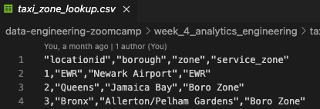
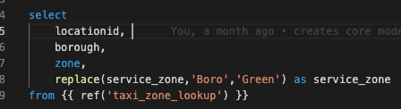
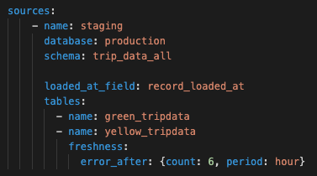

The FROM clause of a dbt model
Sources
The data loaded to our dwh that we use as sources for our models
Configuration defined in the yml files in the models folder
Used with the source macro that will resolve the name to the right schema, plus build the dependencies automatically
Source freshness can be defined and tested
Seeds
CSV files stored in our repository under the seed folder
Benefits of version controlling
Equivalent to a copy command
Recommended for data that doesn’t change frequently
Runs with dbt seed -s file_name

Slide 21
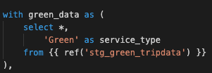
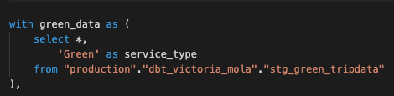
The FROM clause of a dbt model
Ref
Macro to reference the underlying tables and views that were building the data warehouse
Run the same code in any environment, it will resolve the correct schema for you
Dependencies are built automatically
dbt model
Compiled code

Slide 22
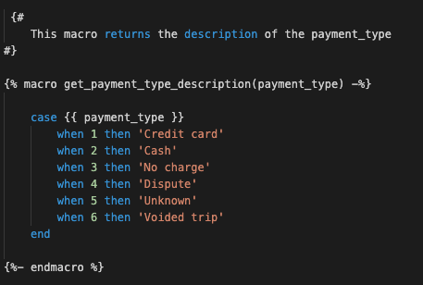
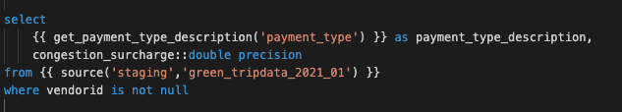
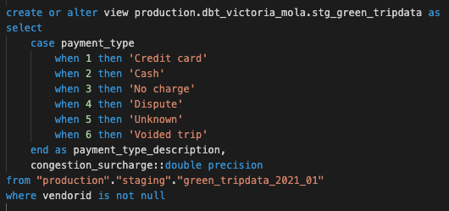
Macros
Use control structures (e.g. if statements and for loops) in SQL
Use environment variables in your dbt project for production deployments
Operate on the results of one query to generate another query
Abstract snippets of SQL into reusable macros — these are analogous to functions in most programming languages.
Usage of the macro
Definition of the macro
Compiled code of the macro

Slide 23
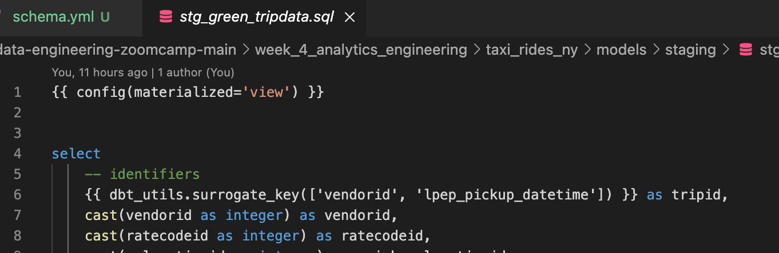
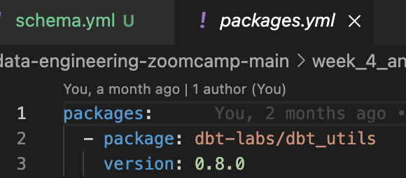
Packages
Like libraries in other programming languages
Standalone dbt projects, with models and macros that tackle a specific problem area.
By adding a package to your project, the package's models and macros will become part of your own project.
Imported in the packages.yml file and imported by running dbt deps
A list of useful packages can be find in dbt package hub
Specifications of the packages to import in the project
Usage of a macro from a package

Slide 24
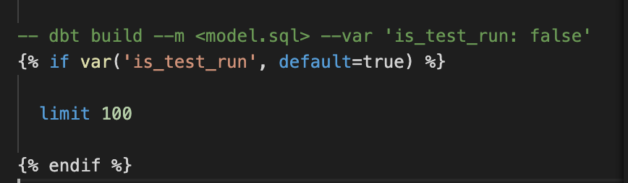
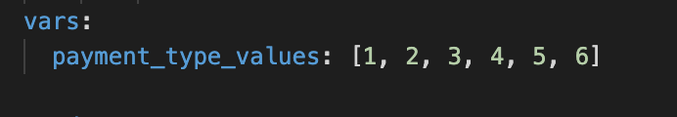
Variables
Variables are useful for defining values that should be used across the project
With a macro, dbt allows us to provide data to models for compilation
To use a variable we use the {{ var('...') }} function
Variables can defined in two ways:
In the dbt_project.yml file
On the command line
Global variable we define under project.yml
Variable whose value we can change via CLI

Slide 25
6
Testing and documenting dbt models
Now to the fun part!

Slide 26
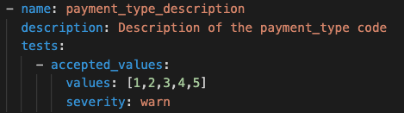
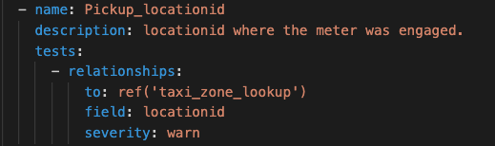
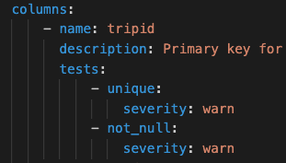
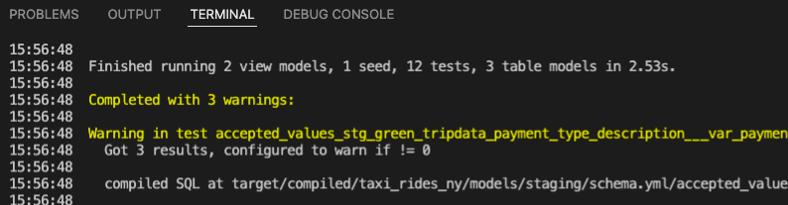

Tests
Definition of basic tests in the .yml files
● Assumptions that we make about our data
● Tests in dbt are essentially a select sql query
● These assumptions get compiled to sql that returns the amount of failing records
● Test are defined on a column in the .yml file
● dbt provides basic tests to check if the column values are:
○ Unique
○ Not null
○ Accepted values
○ A foreign key to another table
● You can create your custom tests as queries
Warnings in the CLI from running dbt test
Compiled code of the not_null test

Slide 27
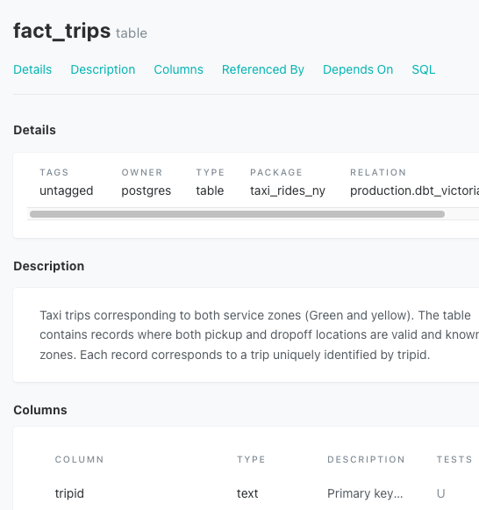
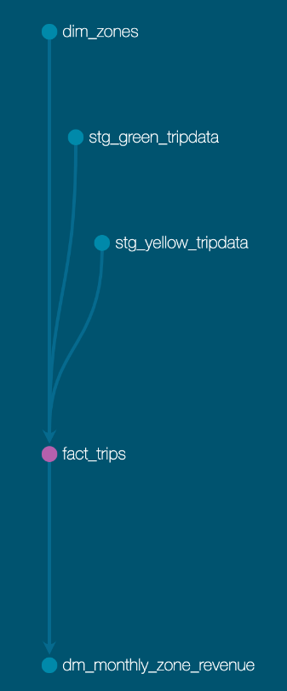
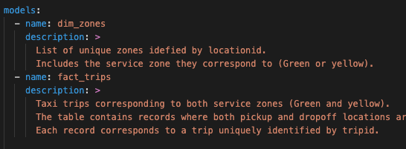
Documentation
dbt provides a way to generate documentation for your dbt project and render it as a website.
The documentation for your project includes:
Information about your project:
Model code (both from the .sql file and compiled)
Model dependencies
Sources
Auto generated DAG from the ref and source macros
Descriptions (from .yml file) and tests
Information about your data warehouse (information_schema):
Column names and data types
Table stats like size and rows
dbt docs can also be hosted in dbt cloud

Slide 28
7
Deployment of a dbt project
Now to the fun part!

Slide 29
What is deployment?
Process of running the models we created in our development environment in a production environment
Development and later deployment allows us to continue building models and testing them without affecting our production environment
A deployment environment will normally have a different schema in our data warehouse and ideally a different user
A development - deployment workflow will be something like:
Develop in a user branch
Open a PR to merge into the main branch
Merge the branch to the main branch
Run the new models in the production environment using the main branch
Schedule the models
Production environment
Deployment (Version control and CI/CD)
Test and document
Develop
Development environment
Image: getdbt.com

Slide 30
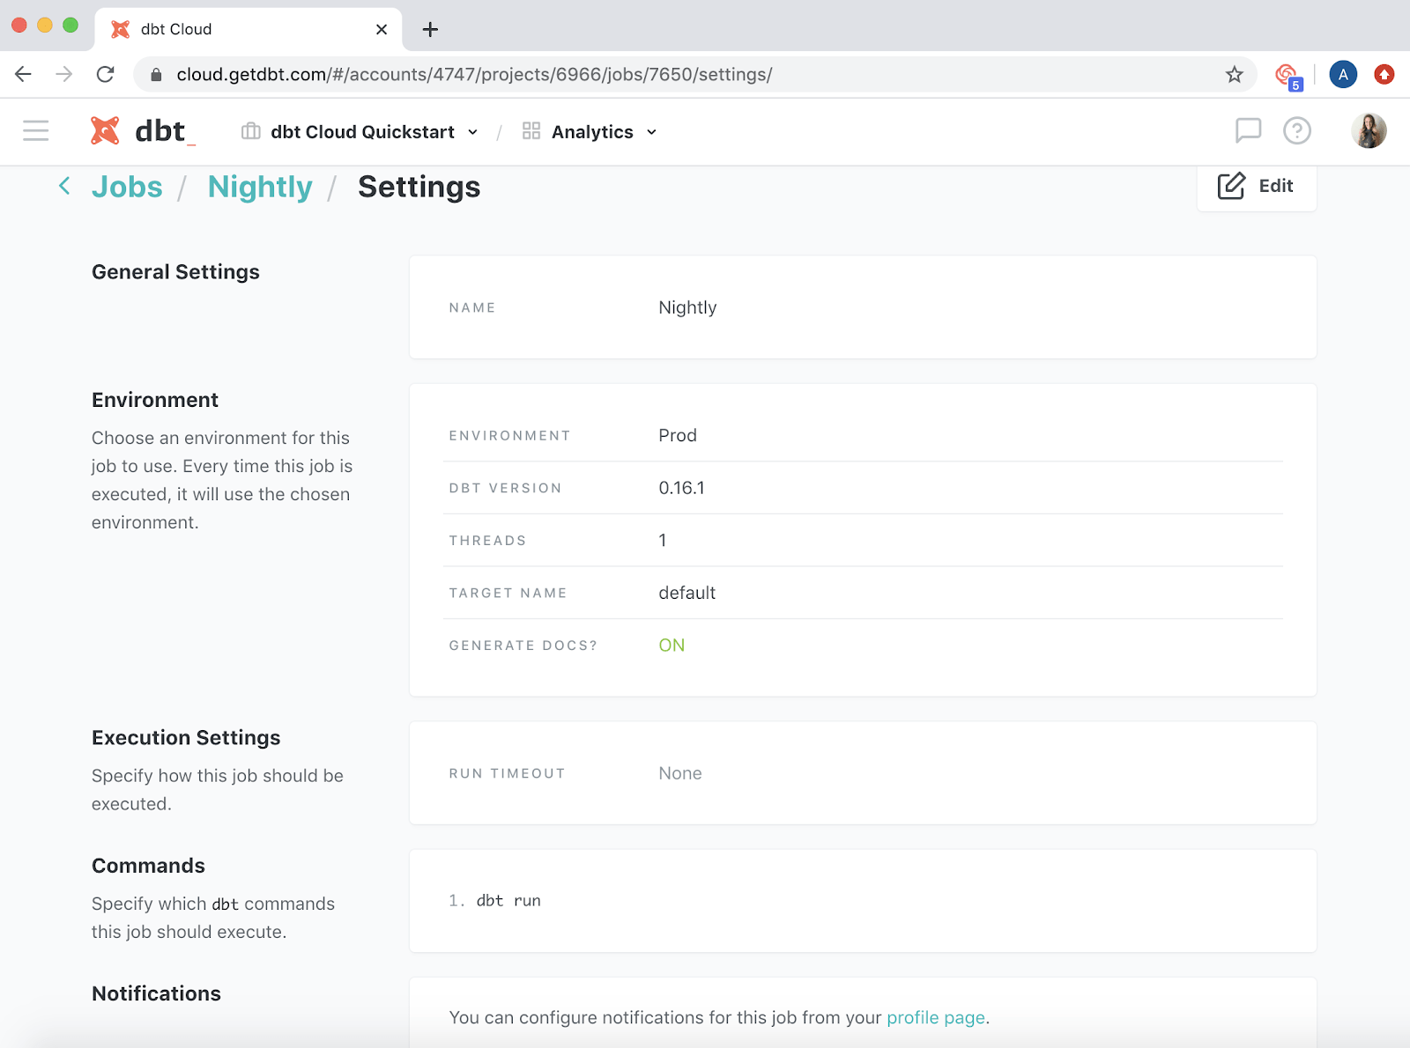
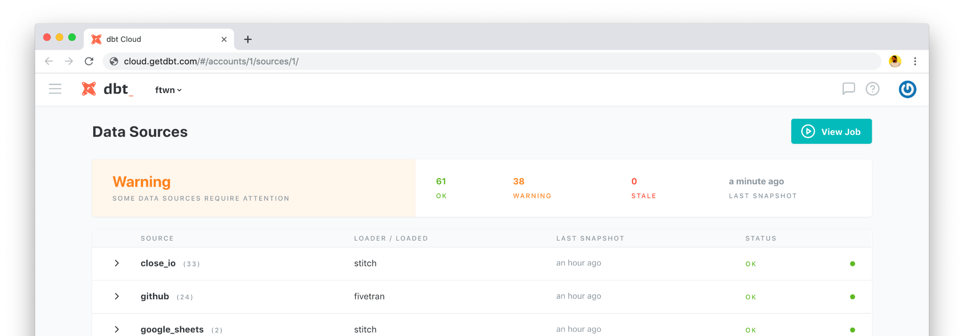
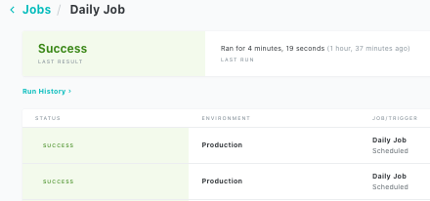
Running a dbt project in production
dbt cloud includes a scheduler where to create jobs to run in production
A single job can run multiple commands
Jobs can be triggered manually or on schedule
Each job will keep a log of the runs over time
Each run will have the logs for each command
A job could also generate documentation, that could be viewed under the run information
If dbt source freshness was run, the results can also be viewed at the end of a job
Image: getdbt.com

Slide 31
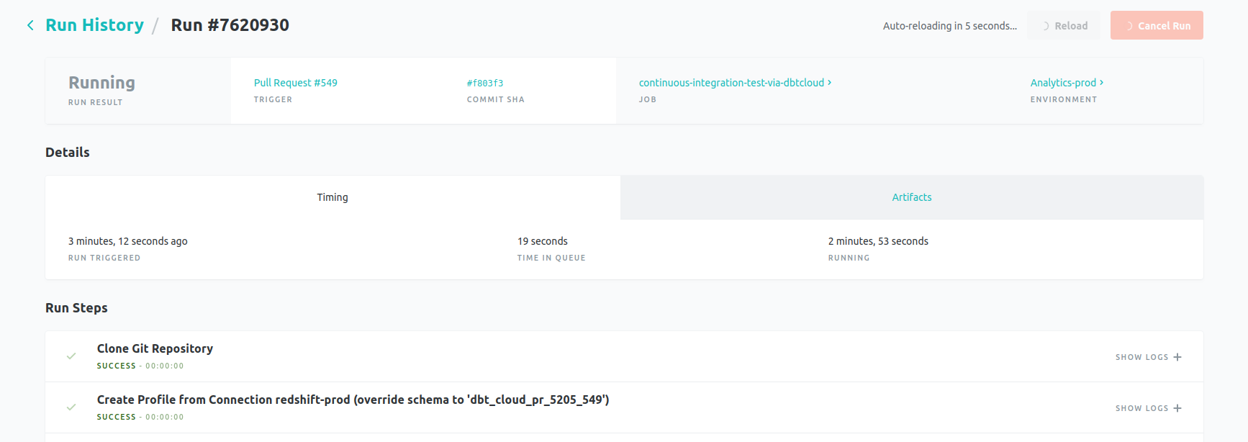
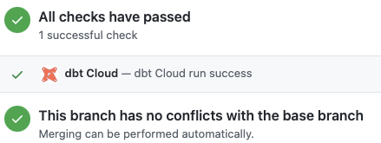
What is Continuous Integration (CI)?
CI is the practice of regularly merge development branches into a central repository, after which automated builds and tests are run.
The goal is to reduce adding bugs to the production code and maintain a more stable project.
dbt allows us to enable CI on pull requests
Enabled via webhooks from GitHub or GitLab
When a PR is ready to be merged, a webhooks is received in dbt Cloud that will enqueue a new run of the specified job.
The run of the CI job will be against a temporary schema
No PR will be able to be merged unless the run has been completed successfully
Image: getdbt.com

Slide 32
8
Visualising the transformed data
Now to the fun part!

